Slide 1


Slide 2
B.venkata Chaitanya Branch:MCA Roll no:25ffmca041 Year: 1st

Slide 3
Hydro power technology

Slide 4
INTRODUCTION
Hydro power generates electricity using flowing or falling water.
Oldest renewable source
Converts kinetic → mechanical → electrical energy

Slide 5
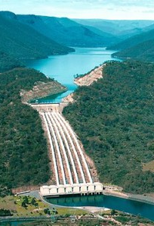
The power of HYDROPOWER
This Photo by Unknown Author is licensed under CC BY-NC-ND

Slide 6
HISTORY
First hydro plant: 1882 (Appleton, USA)
Expanded globally in 20th century
Major renewable contributor today

Slide 7
Working principle
Water from reservoir spins turbines
Turbines drive generators
Electricity is produced and transmitted

Slide 8
Components
• Dam/Reservoir – stores water
• Penstock – directs water flow
• Turbine – converts water to mechanical energy
• Generator – converts mechanical to electrical energy
This Photo by Unknown Author is licensed under CC BY-SA

Slide 9
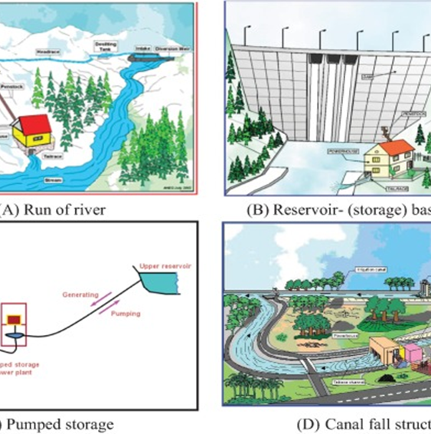
Types of hydro plants
Impoundment (Dam-based)
Run-of-River
Pumped Storage
Used depending on terrain and purpose

Slide 10
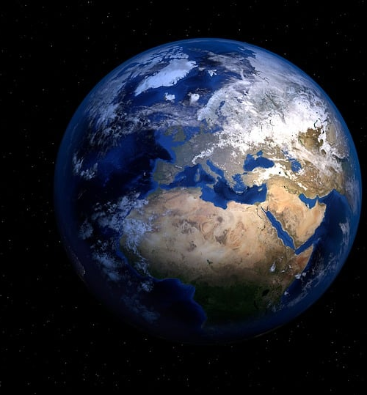
GLOBAL SCENARIO
~16% of world electricity from hydro
• Top countries: China, Brazil, Canada, USA, India
• Expanding in developing nations

Slide 11

advantages
• Renewable & clean
• Low operating costs
• Flood control & irrigation support
• Long lifespan

Slide 12

Disadvantages
• High initial cost
• Displacement of communities
• Ecological imbalance
• Affected by droughts

Slide 13
Environmental impact
Technological Developments
Alters river ecosystems
Methane from reservoirs
Sustainable design needed to minimize harm
Small & micro-hydro tech
Fish-friendly turbines
Smart grid integration

Slide 14
Future of hydropower
Modernizing old dams
Hybrid systems (solar + hydro)
AI-based efficiency optimization

Slide 15
conclusion
Hydro power is reliable and renewable.
Innovation can make it more sustainable.
Key to global clean energy goals.

Slide 16
Thanks you

